Slide 1
Secondary Testosterone deficiency identification using Machine Learning Classifier
Guided By,
Dr. E. Ilavarasan,
Professor, Dept. of CSE, Puducherry Technological University
ANES J 19CS2001 Puducherry Technological University

Slide 2
INTRODUCTION

Slide 3
Testosterone Deficiency
Testosterone is the most important male sex hormone, and its deficiency brings many physical and mental harms.
Testosterone Deficiency Syndrome, or Hypogonadism, is a condition in which a man’s body does not produce sufficient testosterone, the primary male hormone.
This condition generally affects older men, but younger patients can also be affected for a variety of reasons.
It can result to obesity, type 2 diabetes, opioids, or systemic disease and other complications that reduce overall health indicators .

Slide 4
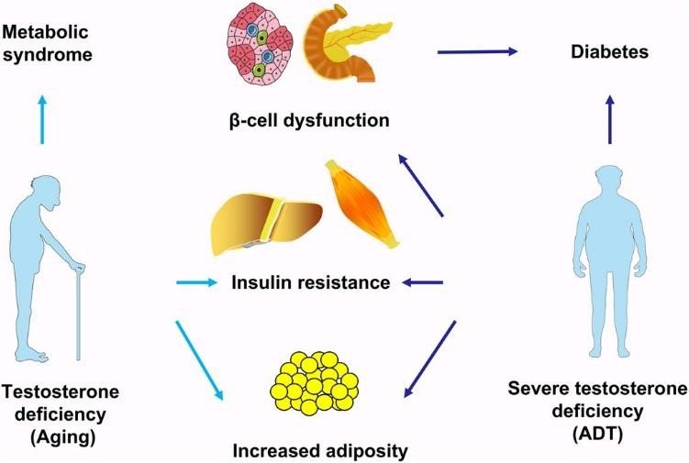
Effects of Testosterone Deficiency

Slide 5
PROBLEM DEFINITION
Accurately predicting secondary testosterone deficiency is important for medical analysis and treatment. However, the existing system for predicting this deficiency is not accurate enough for medical purposes.
Develop a more accurate system for predicting secondary testosterone deficiency using machine learning classifiers.
Accurately predicting secondary testosterone deficiency can lead to better medical outcomes for patients, allowing for earlier detection and treatment of the condition.

Slide 6
OBJECTIVE
To develop the ML model in proposed system that gives more than 95% accuracy to predict testosterone deficiency.
Identification of Testosterone with more accuracy and Finding level of Testosterone using XgBoost algorithm.
Checking with real Clinical Data and Performance improvement from the existing models in terms of Performance metrices.

Slide 7
LITERATURE SURVEY

Slide 8
S.No. | Title | Journal Name | Description | Limitations
1. | Prediction of secondary testosterone deficiency using machine learning: A comparative analysis of ensemble and base classifiers, probability calibration, and sampling strategies in a slightly imbalanced database. | Informatics in Medicine Unlocked/ 2021 | This paper aims to offer a coherent comparative analysis of machine learning methods that can predict testosterone deficiency without having patients undergo costly medical tests. | Threshold levels are very high. Performance levels are lower when compared to the normal clinical analysis.
2. | Predicting Diabetes Mellitus With Machine Learning Techniques | Frontiers in Genetics/ 2018 | The major objective of this article is to predict the occurrence of diabetes mellitus in men using the testosterone data. Machine learning algorithms decision tree, random forest and neural networks are used. | High Computational Time. Possibility of over thinking.

Slide 9
S.No. | Title | Journal Name | Description | Limitations
3. | Applying machine learning techniques to the identification of late-onset hypogonadism in elderly men | Springerplus/ 2016 | This Paper uses two well- known classification techniques, the decision tree (DT) and logistic regression to construct LOH prediction models on the basis of the aforementioned features. | High Dimensionality. Low accuracy.
4. | Heart Disease Identification Method Using Machine Learning Classification in E-Healthcare | IEEE/ 2020 | The Author proposes diagnosis system (FCMIM-SVM) to identify Heart Disease. | The proposed feature selection algorithm (FCMIM) achieves 92.37% accuracy and still need for improvement.

Slide 10
S.No. | Title | Journal Name | Description | Limitations
5. | Identification of Cardiovascular Diseases Using Machine Learning | IEEE/ 2019 | The Author proposes Machine Learning algorithm in identifying a heart disease of a patient and guide a doctor to better diagnose whether a person has cardiovascular disease or not. | Support Vector Machine algorithm achieves 86.8% accuracy and still need for improvement.
6. | Identifying The Predictive Capability of Machine Learning Classifiers For Designing Heart Disease Detection System | IEEE/ 2019 | The Author proposes various Machine Learning classifiers and deep neural network classifiers for designing a medical expert system. | The Ensemble learning techniques have a great effect on SVM classification accuracy and it improved the classification accuracy of 92.30%.

Slide 11
Extraction from Literature Survey
Clinical Data Analysis require more than 95 percentage accuracy to be implemented in real time.
Certain classifiers working well for certain diseases.
There is a need to identify the level of abnormality for the diagnosis purpose.
Working with multiple classifiers enable to identify the suitable classifier for the accurate result.

Slide 12
EXISTING WORK

Slide 13
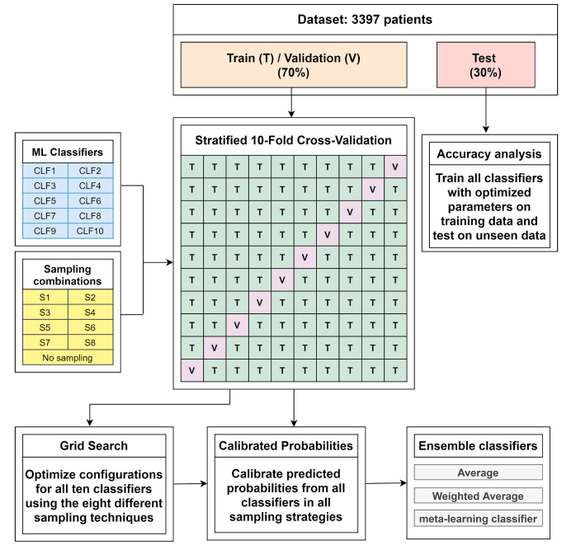

Slide 14
Dataset Name and Link
Dataset Name: Testosterone-Deficiency-Dataset
Dataset Link: https://github.com/osmarluiz/Testosterone-Deficiency-Dataset.git

Slide 15
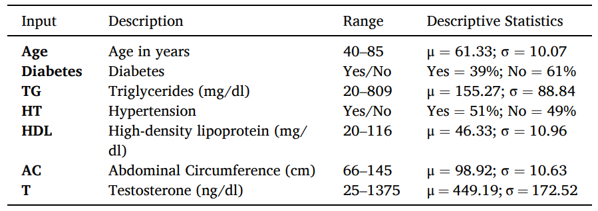
Dataset Attributes

Slide 16
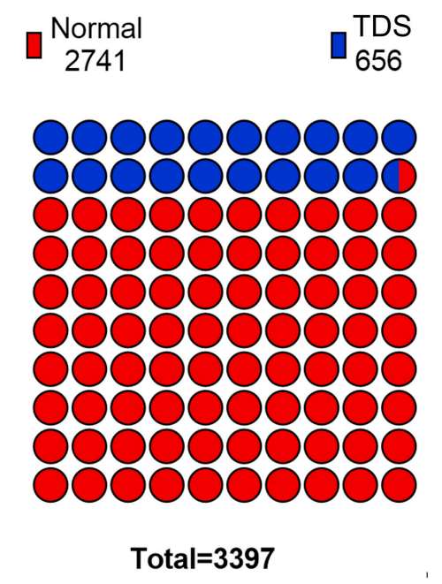

Slide 17
Implementation of Existing System
Module 1:
Implementing Sampling techniques to get balanced data.
Here the used sampling techniques are:
Random under sampling (RUS),
Repeated Edited Nearest Neighbours (RENN),
Random Over-Sampling (ROS),
Synthetic Minority Over-sampling Technique (SMOTE)

Slide 18
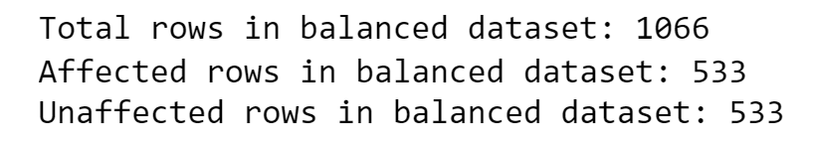
Module 1: UNDER SAMPLING
Random Under Sampling (RUS)
Output:

Slide 19
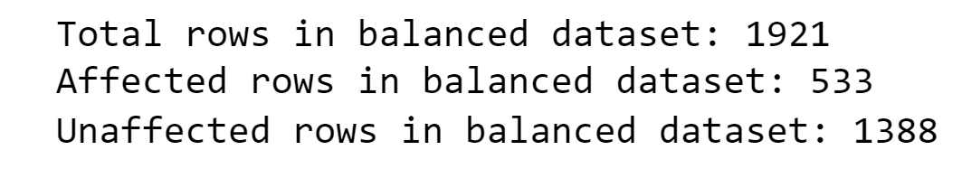
Module 1: UNDER SAMPLING
Repeated Edited Nearest Neighbors (RENN)
Output:

Slide 20
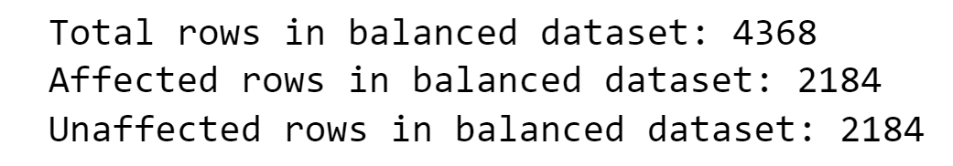
Module 1: OVER SAMPLING
Random Over Sampling (ROS)
Output:

Slide 21
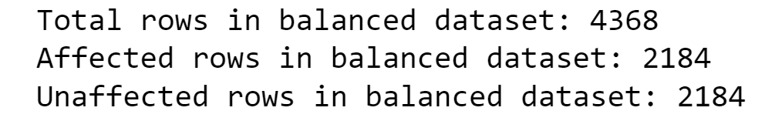
Module 1: OVER SAMPLING
Synthetic Minority Over-sampling Technique (SMOTE)
Output:

Slide 22
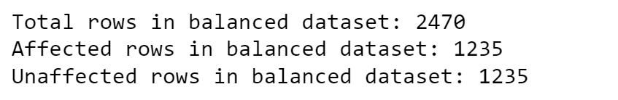
Module 1: HYBRID SAMPLING
Repeated Edited Nearest Neighbors (RENN) + Synthetic Minority Over-sampling Technique (SMOTE)
Output:

Slide 23
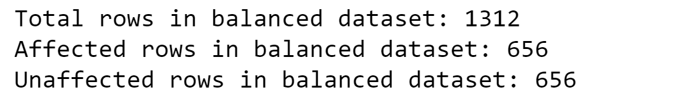
Module 1: HYBRID SAMPLING
Random Under Sampling (RUS) + Random Over Sampling (ROS)
Output:

Slide 24
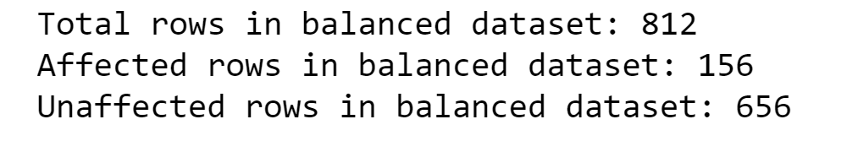
Module 1: HYBRID SAMPLING
Repeated Edited Nearest Neighbors (RENN) + Random Under Sampling (RUS)
Output:

Slide 25
Module 1: HYBRID SAMPLING
Random Under Sampling (RUS) + Synthetic Minority Over-sampling Technique (SMOTE)
Output:

Slide 26
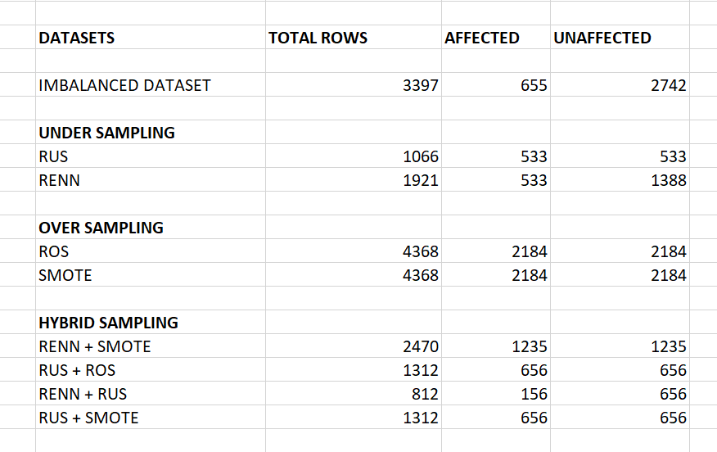

Slide 27
Implementation of Existing System
Module 2:
Implementing Classifier algorithms along with cross validation by giving input as all sampling datasets.
Here the Classifier algorithms are:
Multilayer perceptron classifier
Artificial neural network
Random forest classifier
Extremely randomized trees
Naïve bayes
Knn
Logistic regression
AdaBoost
XgBoost

Slide 28
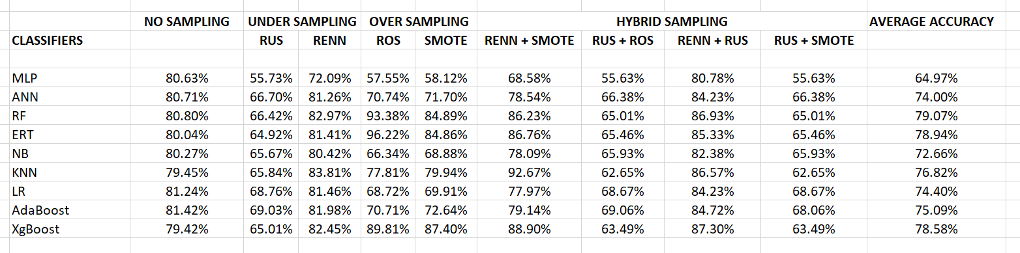
Module 2: CLASSIFIERS

Slide 31
Module 2: CLASSIFIERS
Among all the Classifiers with Over Sampling the RF(Random Forest ) and ERF(Extremely Random Forest) performed the best with the accuracy of 93 and 96 percent.
Using Cross Validation with all datasets RF(79.07%) , ERT(78.94%) and XgBoost(78.58%) produced superior results among all the classifiers used .

Slide 32
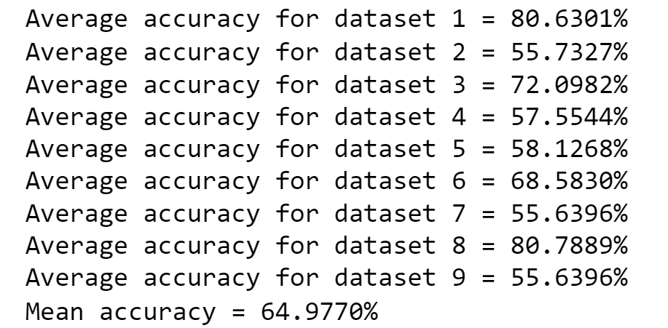
Module 2: Multilayer Perceptron Classifier

Slide 33
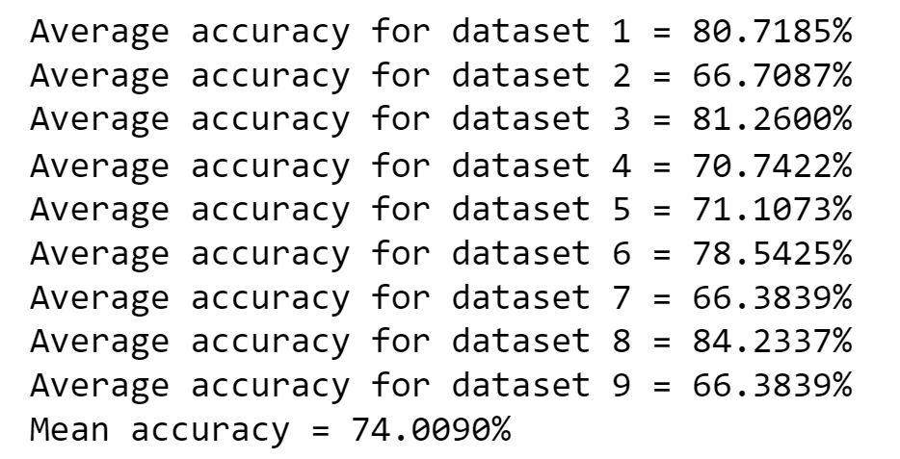
Module 2: Artificial Neural Network

Slide 34
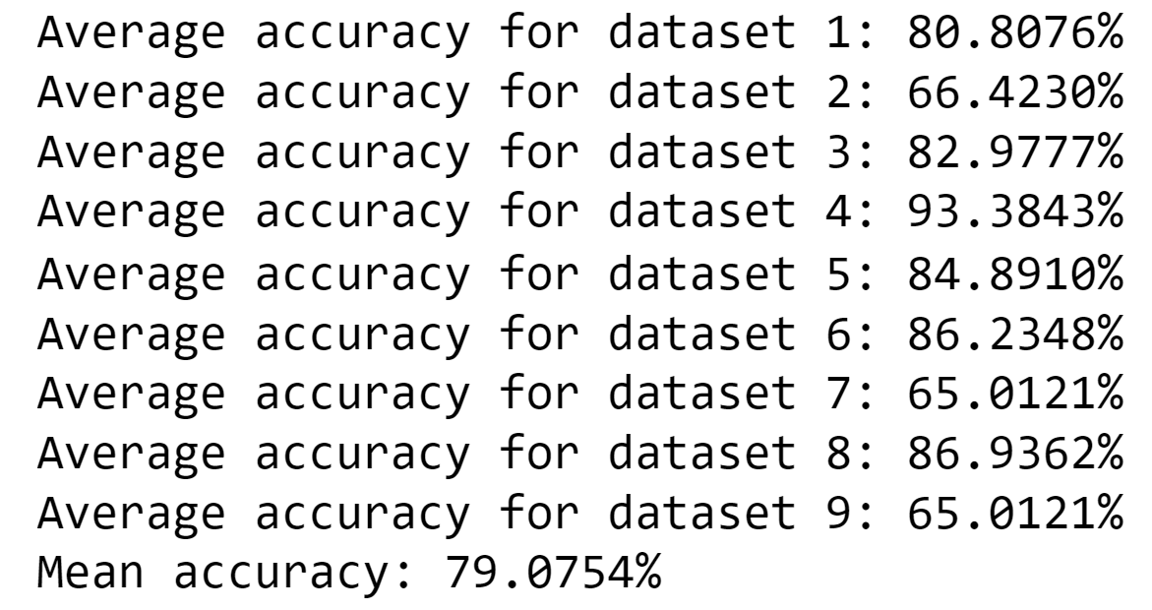
Module 2: Random Forest Classifier

Slide 35
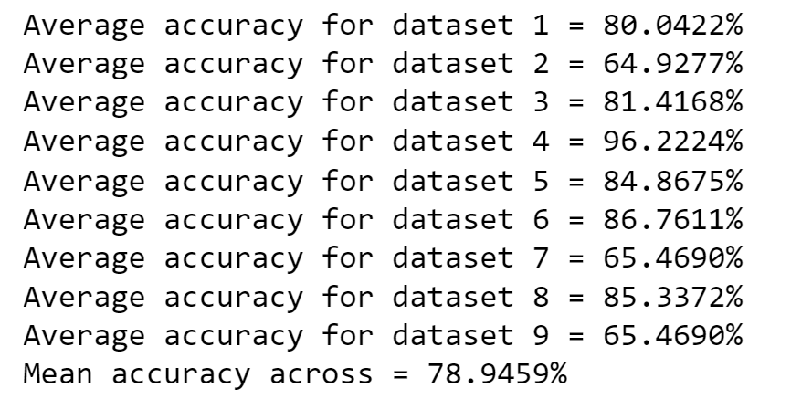
Module 2: Extremely Randomized Trees

Slide 36
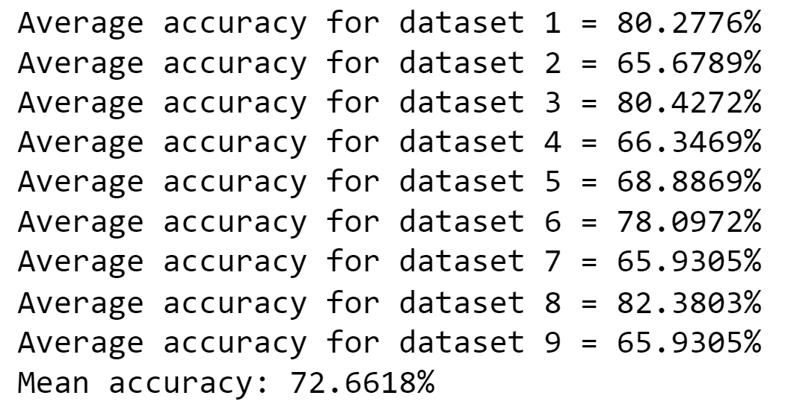
Module 2: Naïve Bayes Classifier

Slide 37
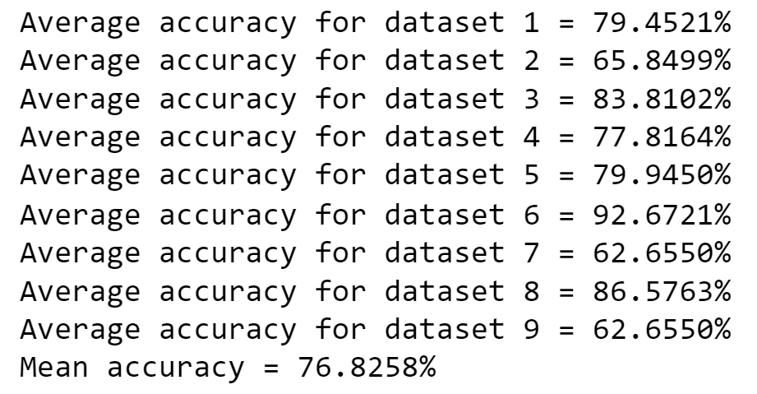
Module 2: k Nearest Neighbour

Slide 38
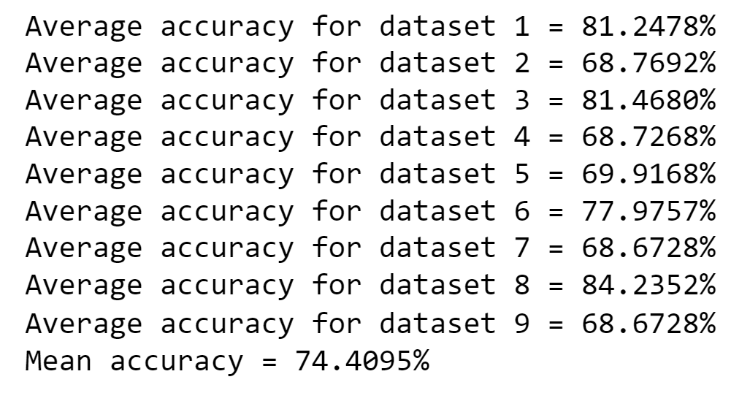
Module 2: Logistic Regression

Slide 39
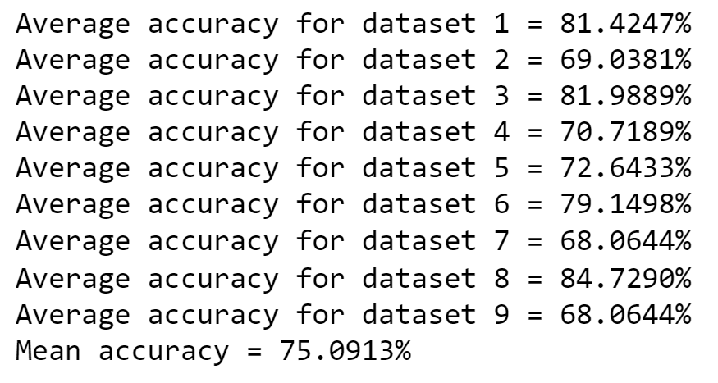
Module 2: AdaBoost

Slide 40
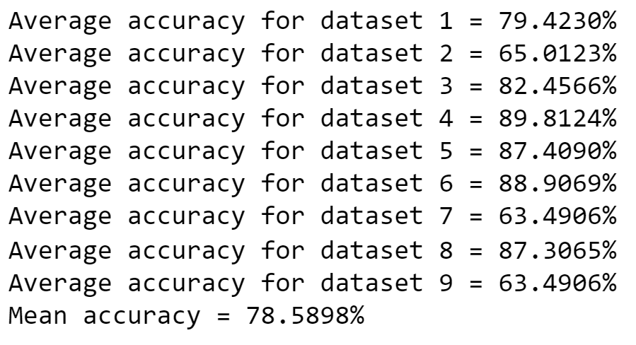
Module 2: XgBoost

Slide 41
PROPOSED WORK

Slide 42
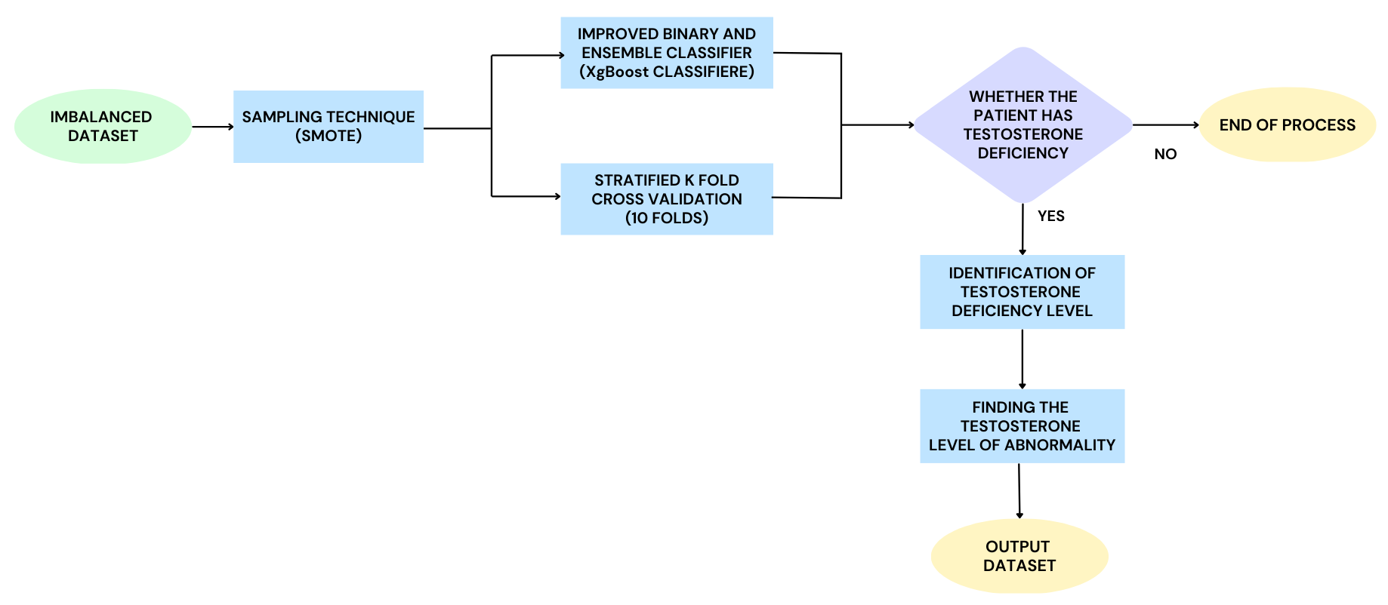
Proposed Design

Slide 43
Implementation of Proposed System
Module 1:
Implementing Sampling techniques to get balanced data.
Here the used sampling techniques are:
Synthetic Minority Over-sampling Technique (SMOTE)

Slide 44
Module 1: SMOTE
Synthetic Minority Over-sampling Technique (SMOTE)
Output:

Slide 45
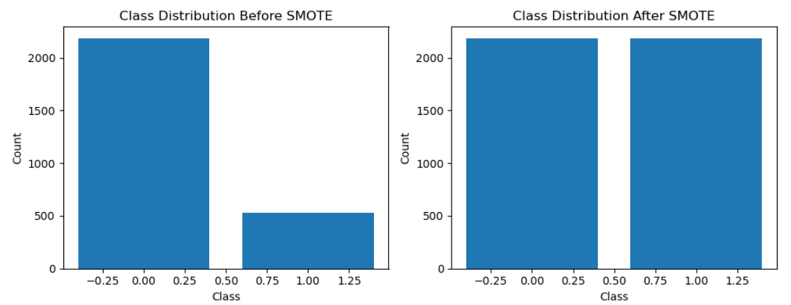

Slide 46
Implementation of Proposed System
Module 2:
Implementing XgBoost model along with stratified k fold cross validation and hyperparameter tuning using random search to get more accuracy.
Finding the level of abnormality.

Slide 47
Module 2: XgBoost Model
Implementing XgBoost model along with stratified 10 fold cross validation and Randomized Search.
Output:

Slide 48
Module 2: XgBoost Model
Using XgBoost Model finding the deficiency percentage and abnormality level only for the patient which has testosterone deficiency.
Generates into new Dataset.

Slide 49
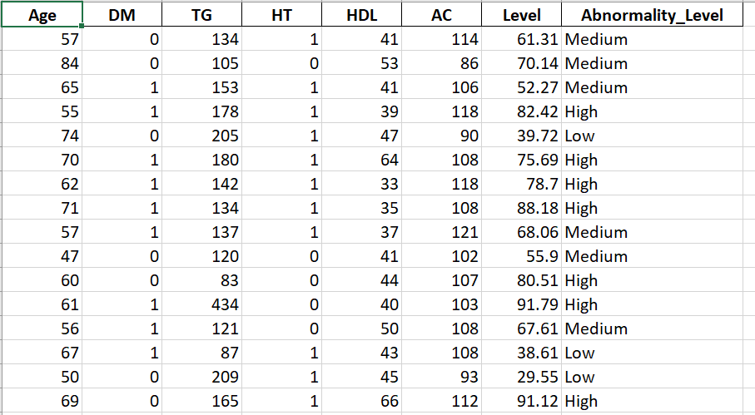
Dataset Name: Final_Output_Dataset

Slide 50
CONCLUSION
Testosterone Deficient Syndrome (TDS) significantly impairs men’s quality of life, but its timely and accurate diagnosis poses a challenge in areas with poor access to public health services. Eight sampling methods for imbalanced datasets, and the calibration of the predicted probabilities to identify a proper method to improve accuracy in TDS diagnosis. The use of these techniques significantly improves ML performance. In the existing system, they try to improve the accurate level, which they got around 70 to 85% by using the Classification and Sampling algorithm. In Sampling strategies, ML algorithms often present bad classification results in imbalanced data. In our proposed system. By using sampling techniques (Smote) we create a new dataset that is trained under xgboost classifiers and stratified K fold cross-validation. The level of abnormality is presented by the age of the people lies between 0 to 40 is low, 41 to 70 is medium, 71 to 100 is High. Overall, we found the accuracy level up to 96% by using various algorithms.

Slide 51
REFERENCES

Slide 52
[1] Monique Tonani Novaes, Osmar Luiz Ferreira de Carvalho, Pedro Henrique Guimar Ferreira, Taciana Leonel Nunes Tiraboschi, Caroline Santos Silva, Jean Carlos Zambrano, Cristiano Mendes Gomes, Eduardo de Paula Miranda, Osmar Abílio de Carvalho Junior, and Jos´e de Bessa Junior,”Prediction of secondary testosterone deficiency using machine learning: A comparative analysis of ensemble and base classifiers, probability calibration, and sampling strategies in a slightly imbalanced dataset” , Science Direct Journal Informatics in Medicine Unlocked 23 (2021) 100538
[2] Quan Zou1, Kaiyang Qu, Yamei Luo, Dehui Yin, Ying Ju, and Hua Tang,” Predicting Diabetes Mellitus With Machine Learning Techniques”, Article of Frontiers in Genetics November 2018 | Volume 9 | Article 515
[3] Ti Lu, Ya-Han Hu, Chih-Fong Tsai, Shih-Ping Liu, and Pei-Ling Chen,” Applying machine learning techniques to the identification of late-onset hypogonadism in elderly men”, SpringerPlus Article June 2016
[4] Shaker El-Sappagh, Mohammed Elmogy , Farman Ali, Tamer ABUHMED, S. M. Riazul Islam, and Kyung-Sup Kwak,” A Comprehensive Medical Decision–Support Framework Based on a Heterogeneous Ensemble Classifier for Diabetes Prediction”, MDPI Article May 2019.

Slide 53
[5] Rahul C, Merin Meleet, G.N. Srinivasan, and Nagaraj G Cholli,” Clinical Data Analysis For Recognizing Named Entities”, 2021 IEEE International Conference on Computation System and Information Technology for Sustainable Solutions (CSITSS) November 2021
[6] Amin Ul Haq1, Jianping Li1*, Jalaluddin Khan1, Muhammad Hammad Memon1, Shadma Parveen3, Mordecai Folarin Raji1, Wasif Akbar1, Tanvir Ahmad2, Sana Ullah4, Latipova Shoista1, Happy N. Monday1,” Identifying The Predictive Capability of Machine Learning Classifiers for Designing Heart Disease Detection System”, 16th International Computer Conference on Wavelet Active Media Technology and Information Processing 2019
[7] Nabaouia Louridi, Meryem Amar, Bouabid and El Ouahidi, ”Identification of Cardiovascular Diseases Using Machine Learning”, 7th Mediterranean Congress of Telecommunications (CMT) 2019
[8] Jian Ping Li ;Amin Ul Haq;Salah Ud Din, Jalaluddin Khan, Asif Khan, and Abdus Saboor,”Heart Disease Identification Method Using Machine Learning Classification in E-Healthcare”, IEEE Journal Vol: 8, 2020

Slide 54
Thank You

